Slide 1
Dream Storm
Loneliness in Older Adults in NZ

Slide 2
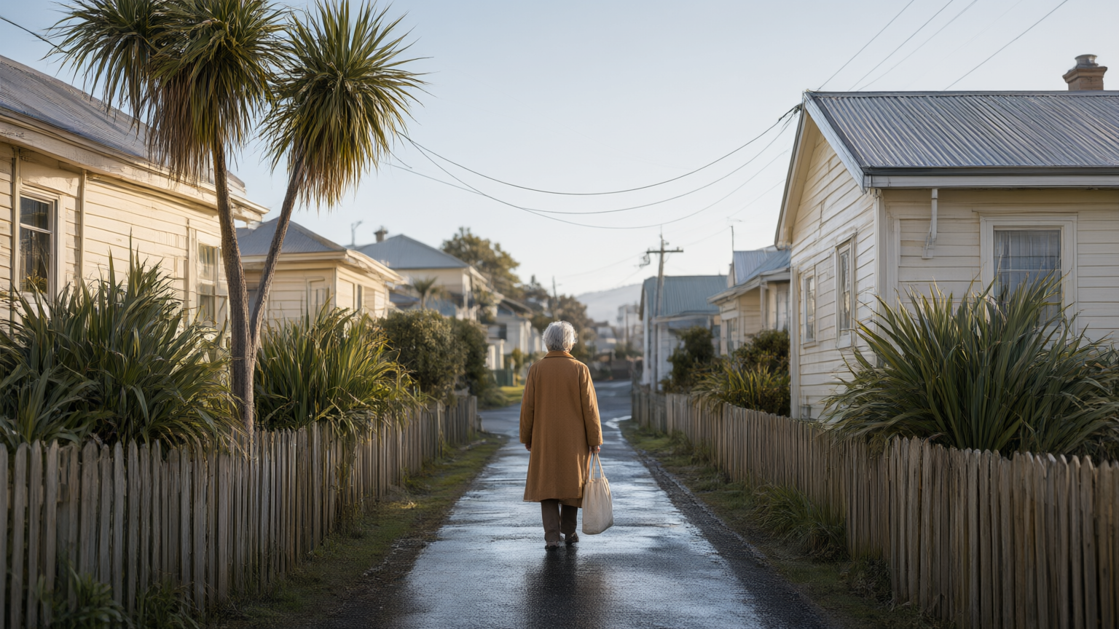
Someone you love is getting older.

Slide 3
New Zealand is getting older
21%
17%
15%
2018
Today
2034
Loneliness raises the risk of
+32%
+29%
+26%
+50%
stroke
heart disease
premature death
dementia

Slide 4
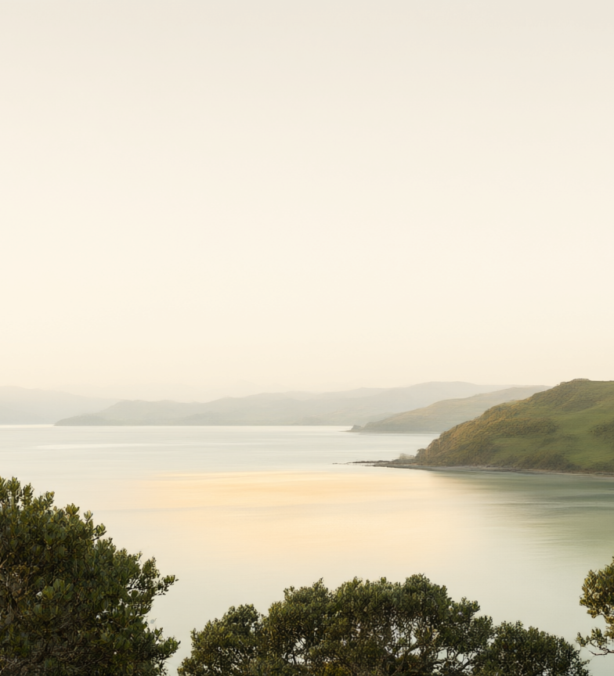
We are trying…
A national ageing strategy. A UN healthy-ageing commitment.
Loneliness is one of seven indicators the Government used
to track older New Zealanders' wellbeing.

Slide 5

An overburdened health system
What if we could catch the loneliness before it becomes a hospital bed?

Slide 6
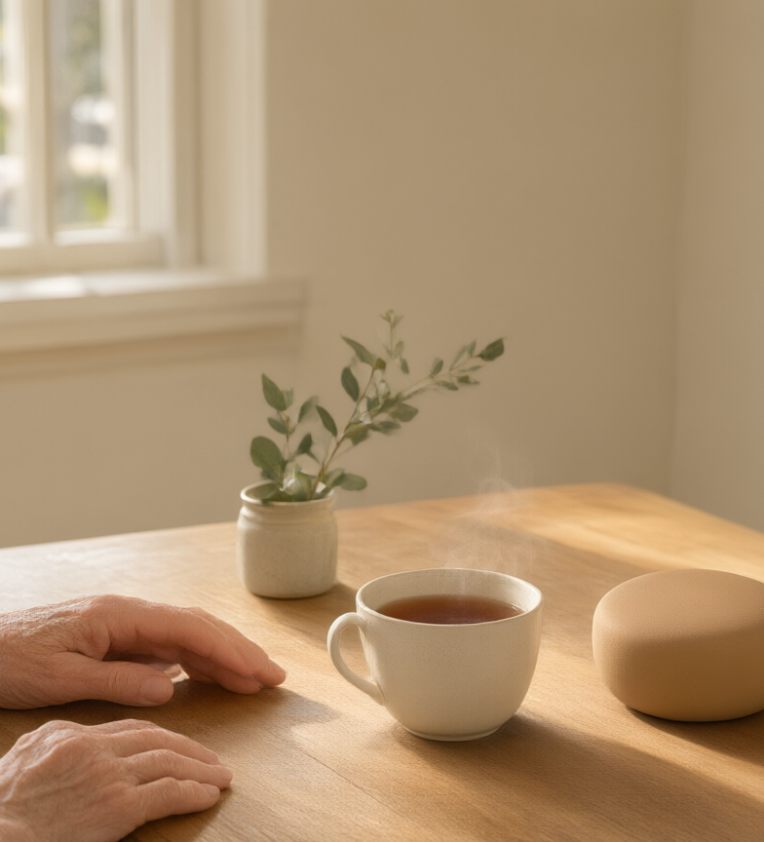
Koa
An AI companion for older adults living alone, that listens,
gently reminds, and encourages social connection.

Slide 7
How it works
A conversational companion that listens, supports and remembers.
→ place the original HOW IT WORKS artwork here

Slide 8

Demo

Slide 9
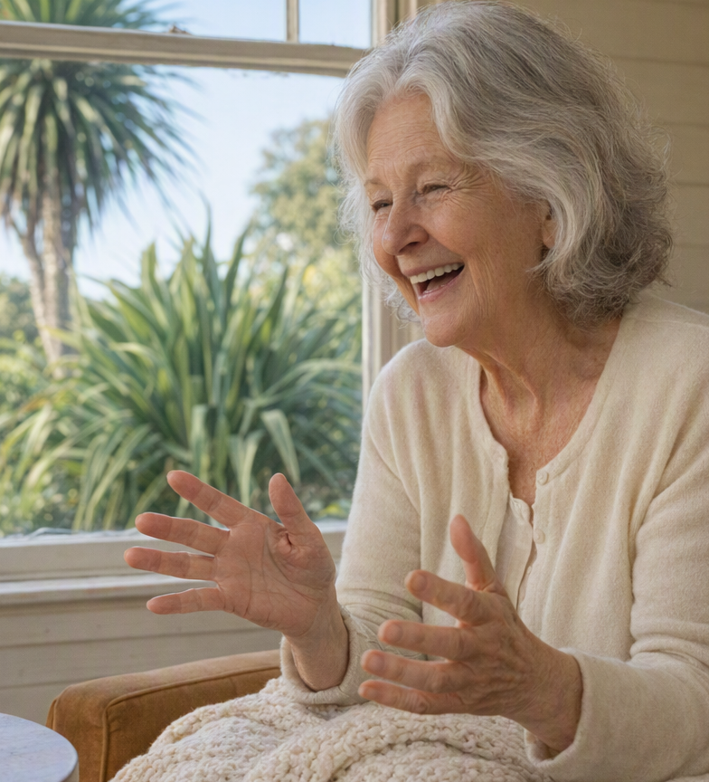
What we built
It's not a device. It's the layer that makes any device safe to talk to.
It's speech-first — the only interface she doesn't have to learn.
It's tikanga-led.

Slide 10
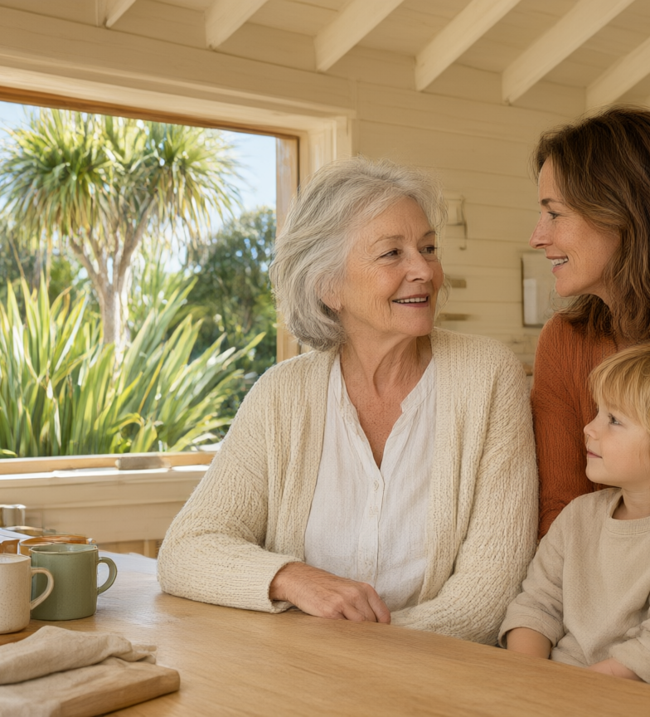
It's always Margaret. It just does more for her.
One install, one relationship — and a market that roughly doubles
as we grow into it.

Slide 11
Impact statement
[TO COMPLETE BEFORE PITCH]
What changes for the person? For NZ?
Which UN SDG targets does it hit, by number?
What is the number that makes it fundable?
What is the closing line?

Slide 12
Thank you

Slide 13
One bridge. Three phases. Three wallets.
Phase 1 · Whānau Bridge Phase 2 · Care aid Phase 3 · Guardian
NZ$65 per resident, per month

Slide 14
Build-on plan
What exists today, and what comes next?

Slide 15
What exists, when.
Eleven functions. A dot fills and never empties again.
→ place the original HOW IT WORKS artwork here

Slide 16
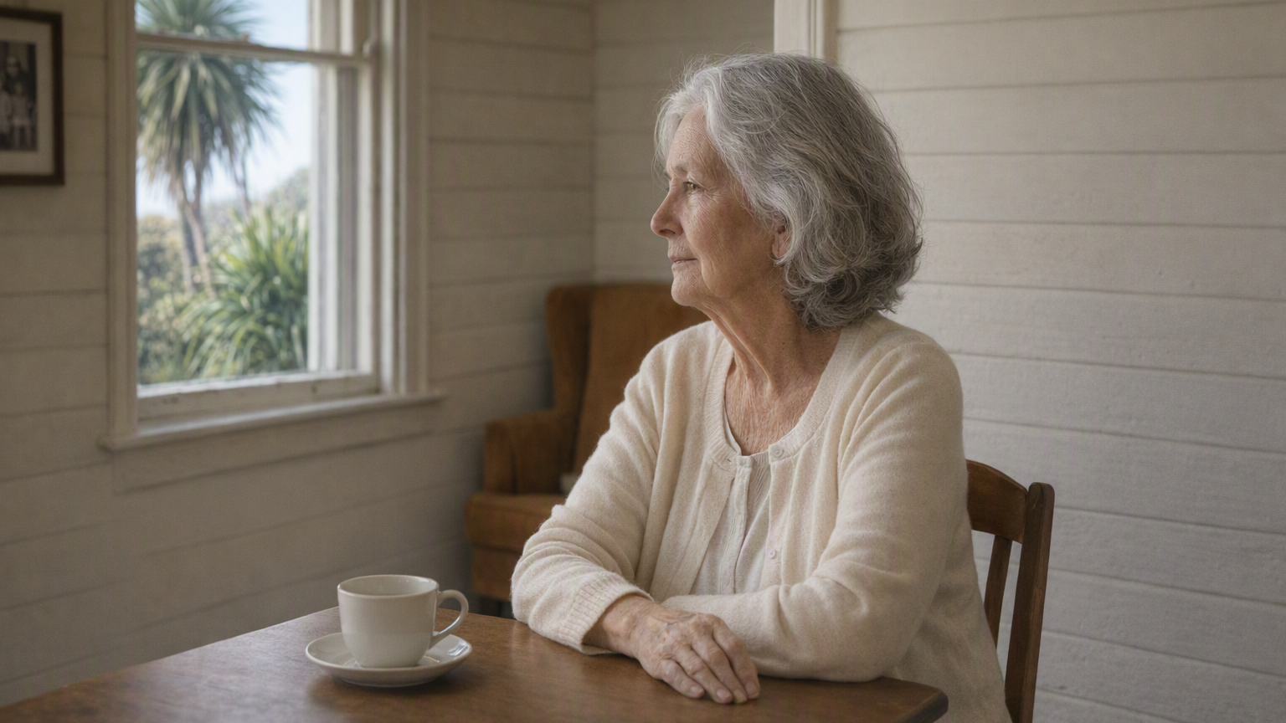
No one notices the shift
From “out a few times a week” to “hasn't left the house in eleven days.”

Slide 17
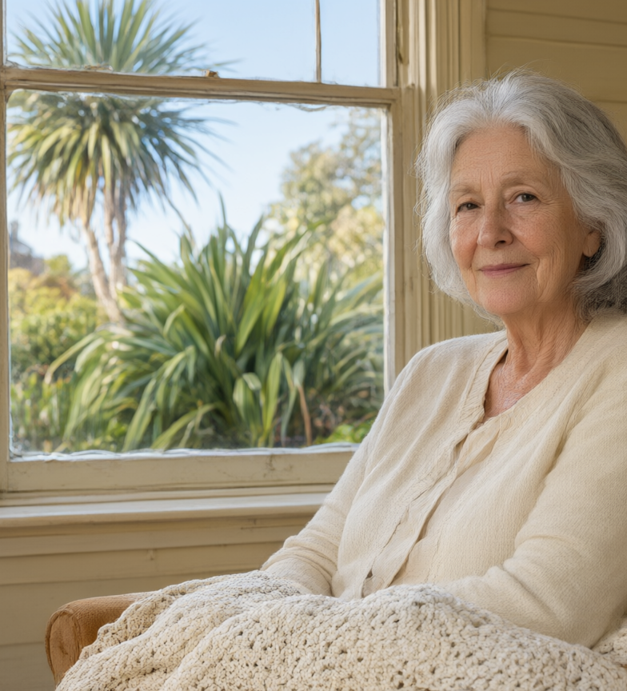
Meet Margaret
Retired, lives alone in West Auckland.
Takes the bus to the shops a few times a week.
“I come home, close the door, and it's like the whole house goes silent.
That's when the loneliness sets in…”

Slide 18
Someone you love is getting older.
1 in 5
New Zealanders aged 65+ felt lonely in the last four weeks.
Stats NZ · Health and Lifestyles Survey

Slide 19
Kia noho ora tonu ngā kaumātua
Older New Zealanders lead valued, connected and fulfilling lives.
He Oranga Kaumātua 2019–2034 — a UN healthy-ageing commitment.

Slide 20
We can't even meet the need today.
Older New Zealanders living alone today
192,201
Most get no regular help at all.
There aren't enough carers or volunteers to change that.
Stats NZ, 2023 Census · 192,201 people aged 65+

Slide 21
Koa — a bridge to everyday connection
Koa lives with Margaret as a small, soft companion she can talk to every day.

Slide 22
The impact it will have
[TO COMPLETE BEFORE PITCH]

