Slide 1
Koa
A bridge to everyday connection

Slide 2
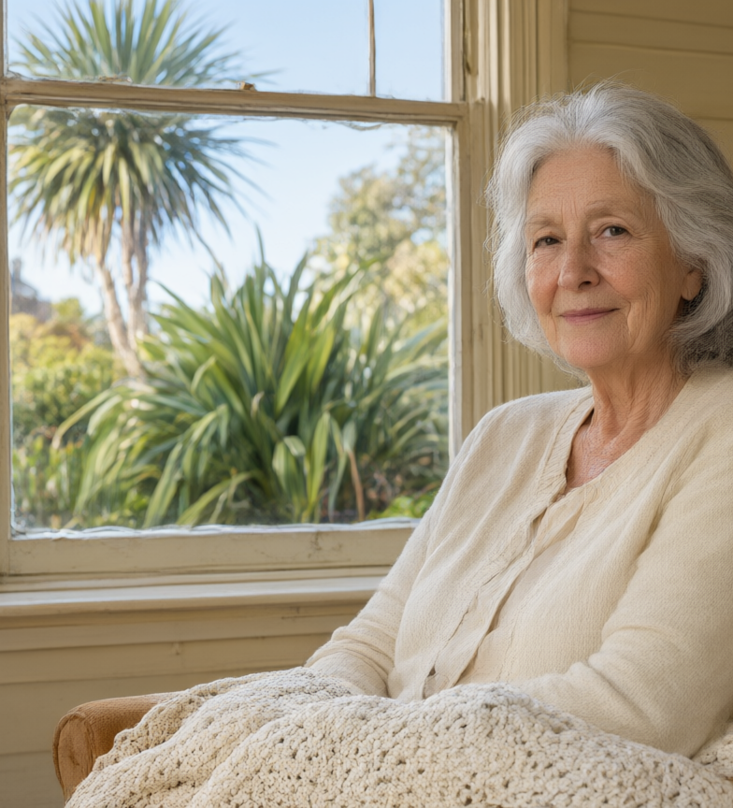
Meet Margaret
74. Retired. Lives alone in West Auckland.
Takes the bus to the shops a few times a week.
“I come home, close the door, and it's like the whole house goes silent.”

Slide 3
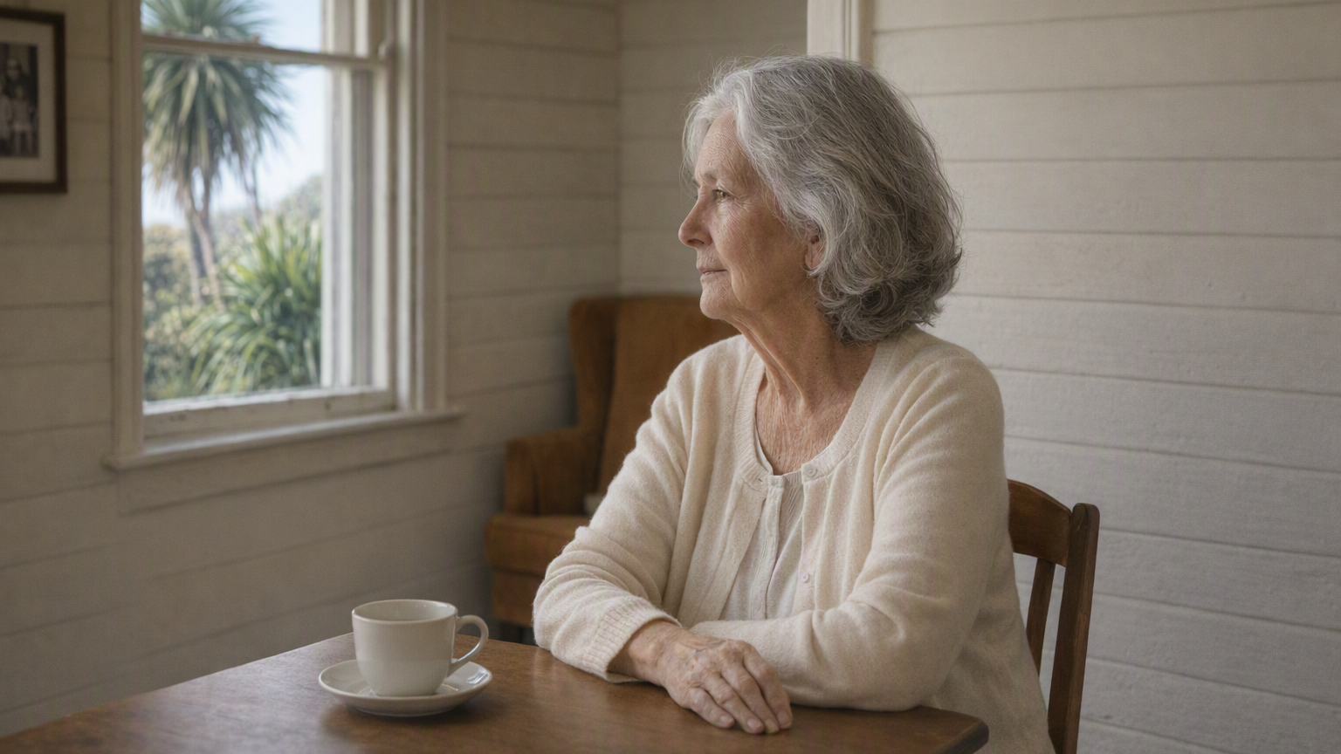
No one notices the shift
From “out a few times a week” to “hasn't left the house in eleven days.”

Slide 4
It isn't just Margaret
192,201
New Zealanders aged 65+ live alone — a quarter of all over-65s,
and half of everyone in the country who lives alone.
Stats NZ · 2023 Census

Slide 5
And the group is growing
21%
17%
15%
2018
Today
2034
Loneliness raises the risk of
+32%
+29%
+26%
+50%
stroke
heart disease
premature death
dementia

Slide 6
We can't even meet the need today
Older New Zealanders living alone today
192,201
Most get no regular help at all.
There aren't enough carers or volunteers to change that.
Stats NZ, 2023 Census · 192,201 people aged 65+

Slide 7

This ends in a hospital bed
What if we could catch the loneliness before it got there?

Slide 8
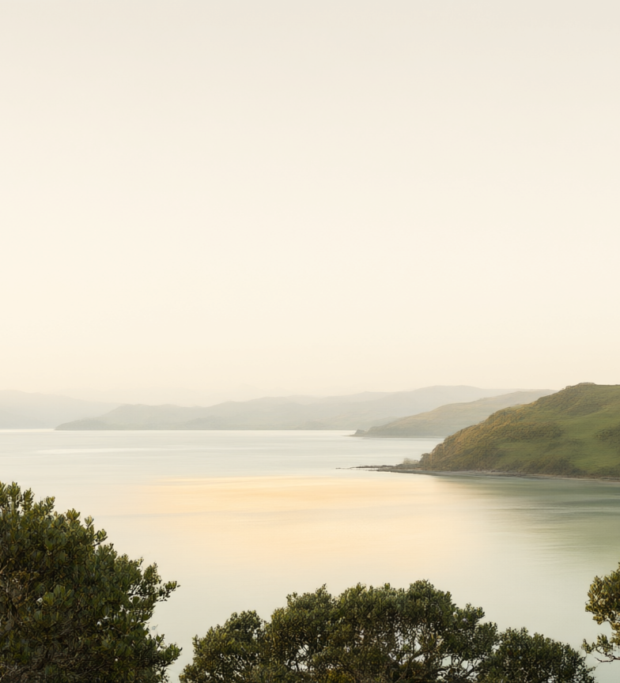
Kia noho ora tonu ngā kaumātua
He Oranga Kaumātua 2019–2034.
Loneliness is one of seven wellbeing indicators the Government tracked.

Slide 9
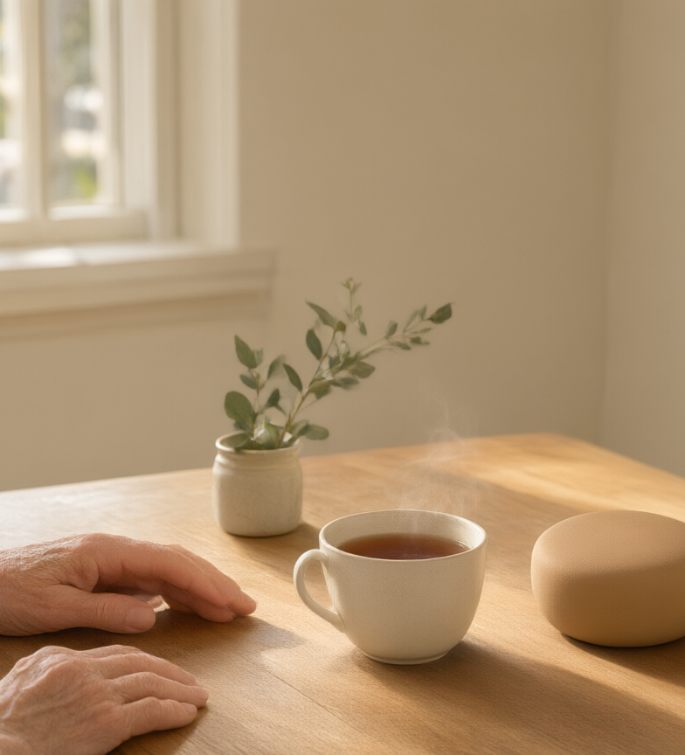
Koa
An AI companion for older adults living alone.
It listens, gently reminds, and encourages connection.

Slide 10
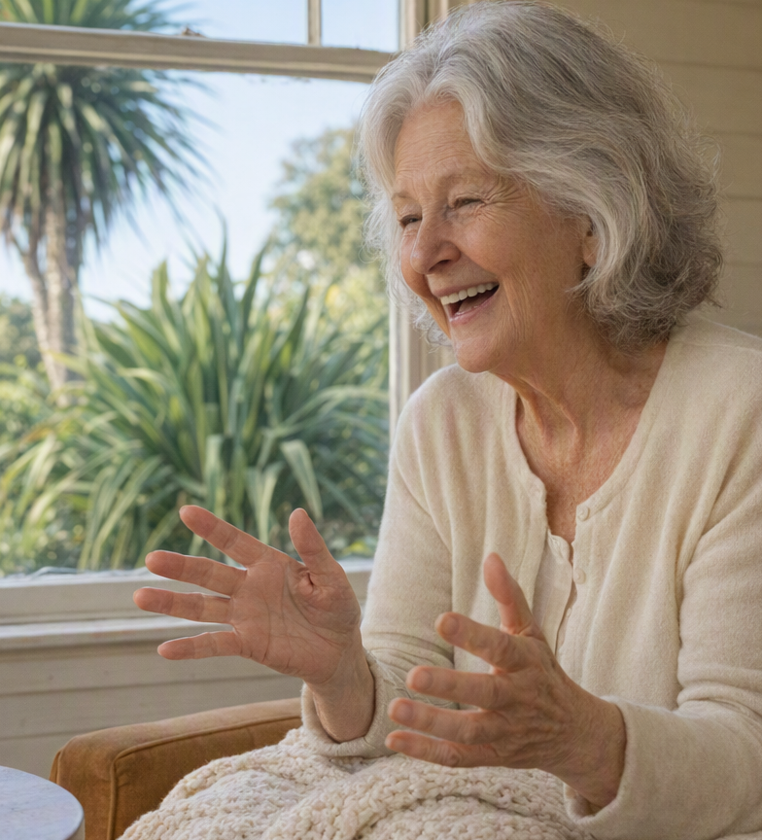
What we built
Not a device — the layer that makes any device safe to talk to.
Speech-first: the only interface she doesn't have to learn.
Tikanga-led: The Kete holds her memory, private and hers.

Slide 11

Demo

Slide 12
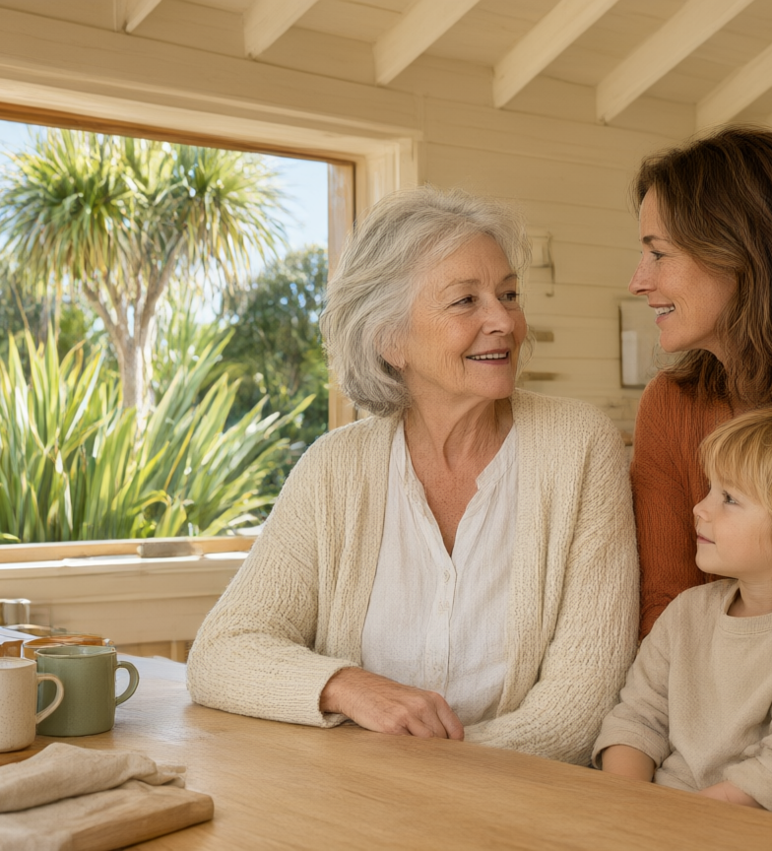
One install, one relationship
Phase 1 · Whānau Bridge — the family pays
Phase 2 · Care aid — NZ$65 per resident, per month
Phase 3 · Guardian

Slide 13
Impact
[SDG TARGETS TO STATE BY NUMBER]
For Margaret: someone who knows her, every day.
For NZ: 192,201 people living alone, one install each.
SDG targets: ___ The number that makes it fundable: ___

Slide 14
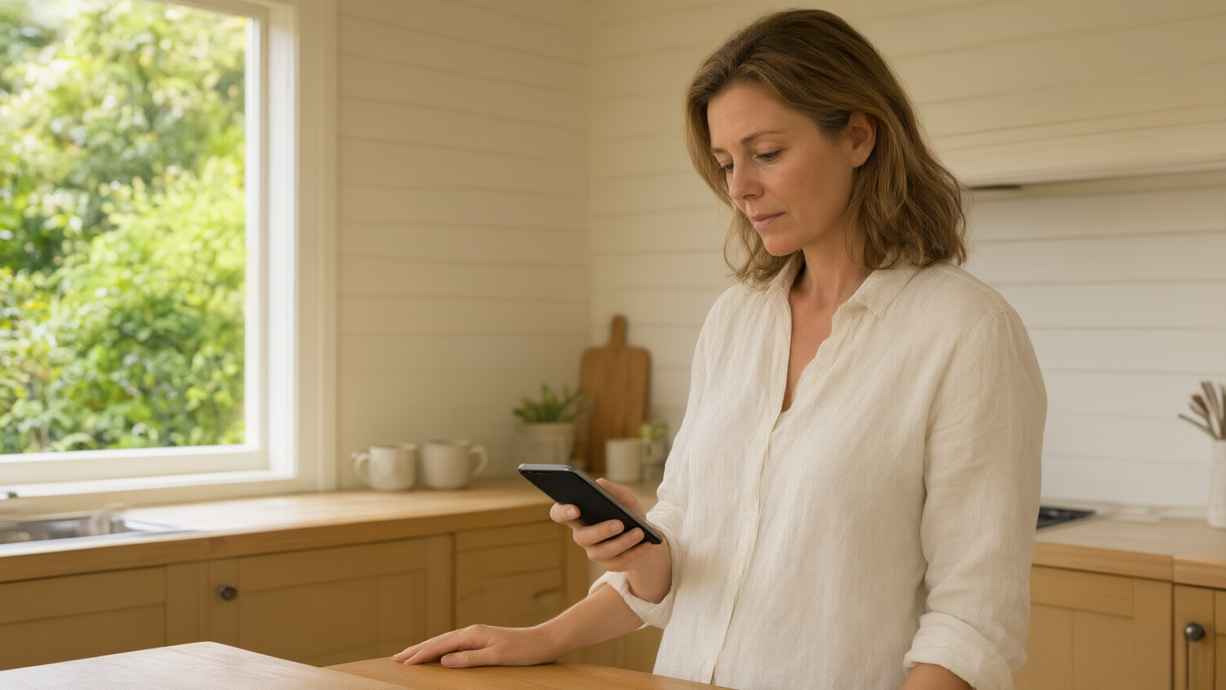
Thank you
Koa — a bridge to everyday connection

