Slide 1
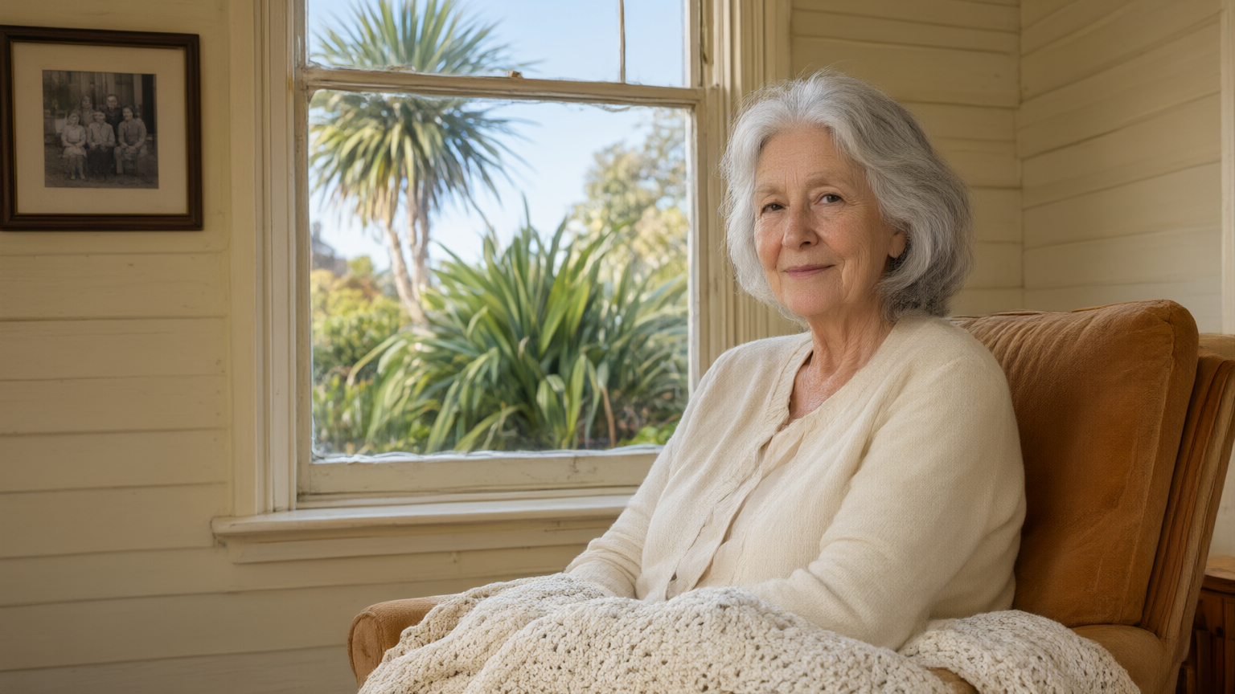
This is Margaret.
74. Lives alone in West Auckland.

Slide 2
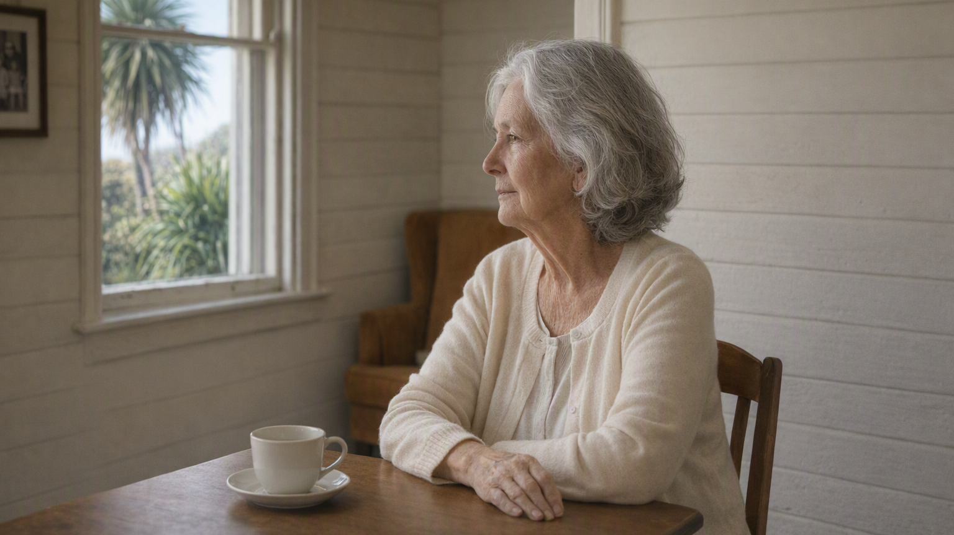
Eleven days since she left the house.
Nobody noticed.

Slide 3
192,201
New Zealanders aged 65+ live alone.
A quarter of all over-65s.
Stats NZ · 2023 Census

Slide 4
And there aren't enough carers to change that.
Older New Zealanders living alone today
192,201
Most get no regular help at all.
There aren't enough carers or volunteers to change that.
Stats NZ, 2023 Census · 192,201 people aged 65+

Slide 5
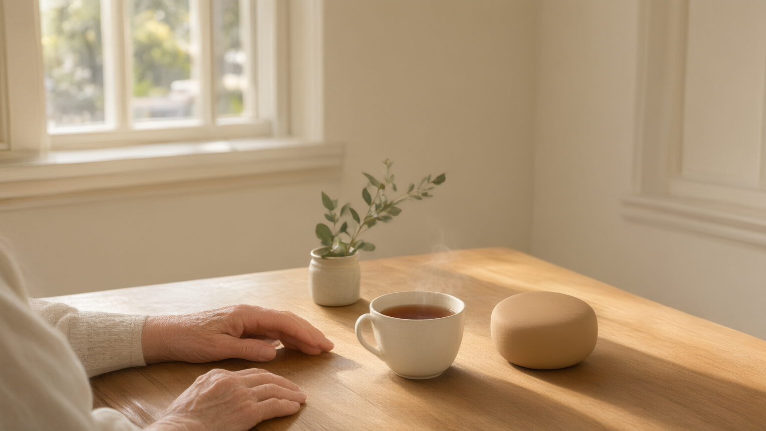
Koa.
Someone to talk to. Every day.

Slide 6
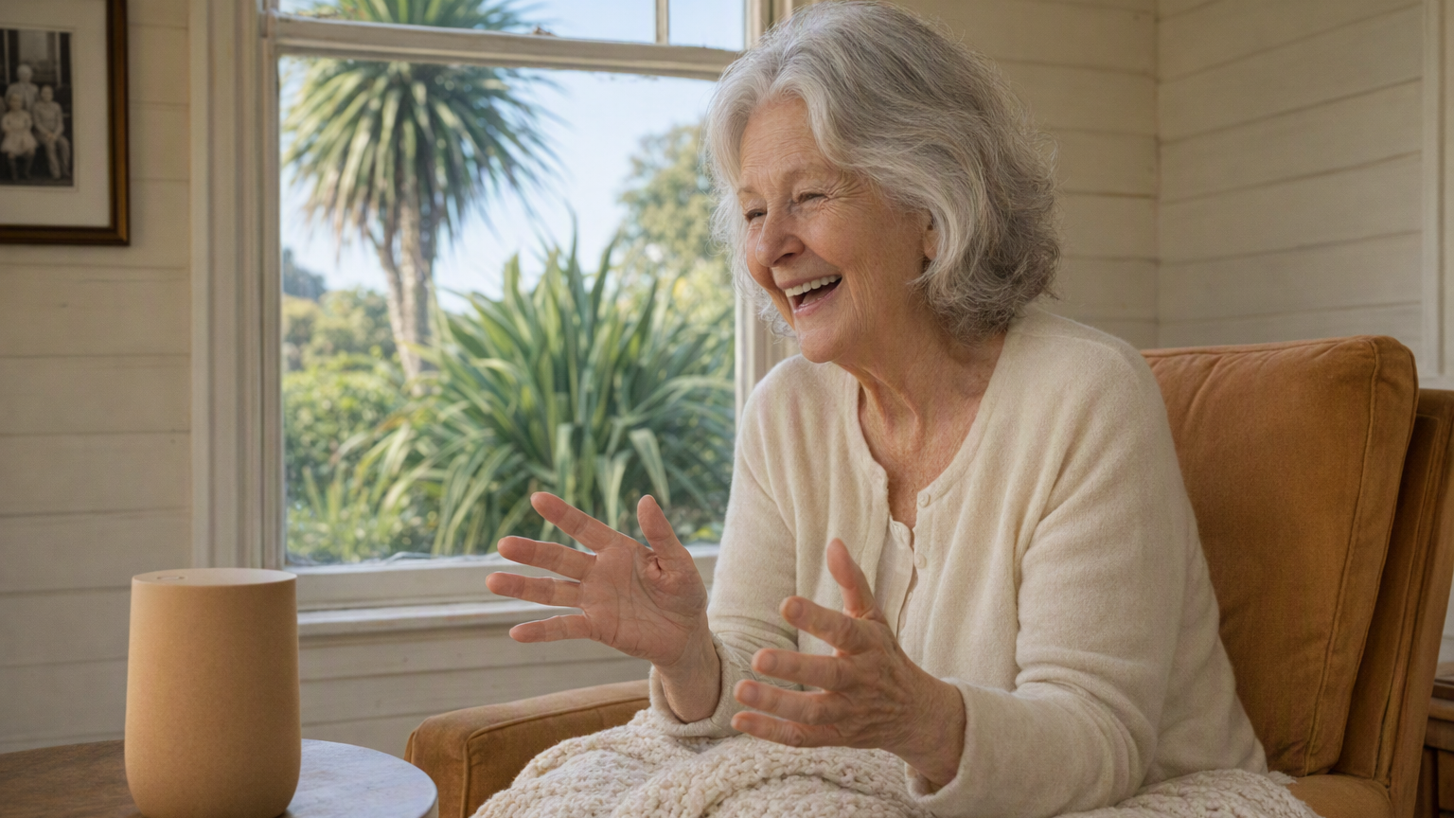
Not a device.
The layer that makes any device safe to talk to.

Slide 7
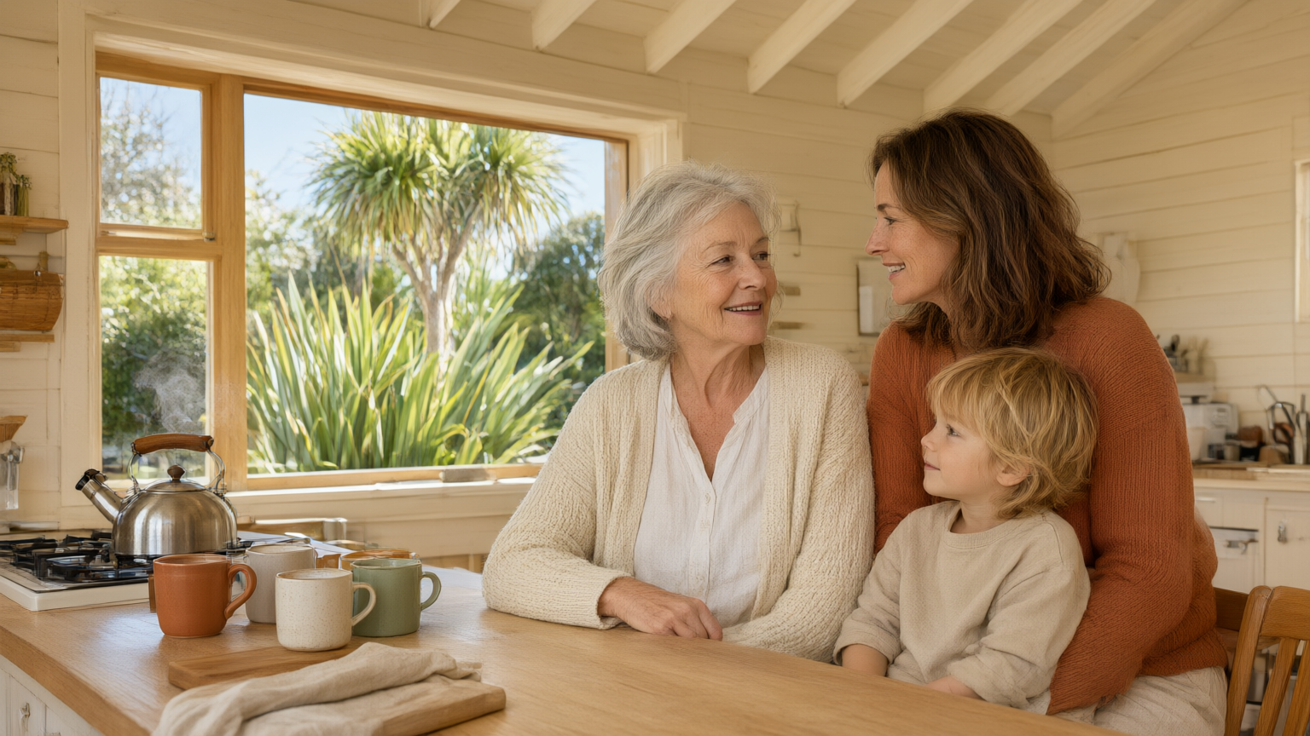
One install. One relationship.
Whānau. Care. Guardian.

Slide 8

Demo

Slide 9
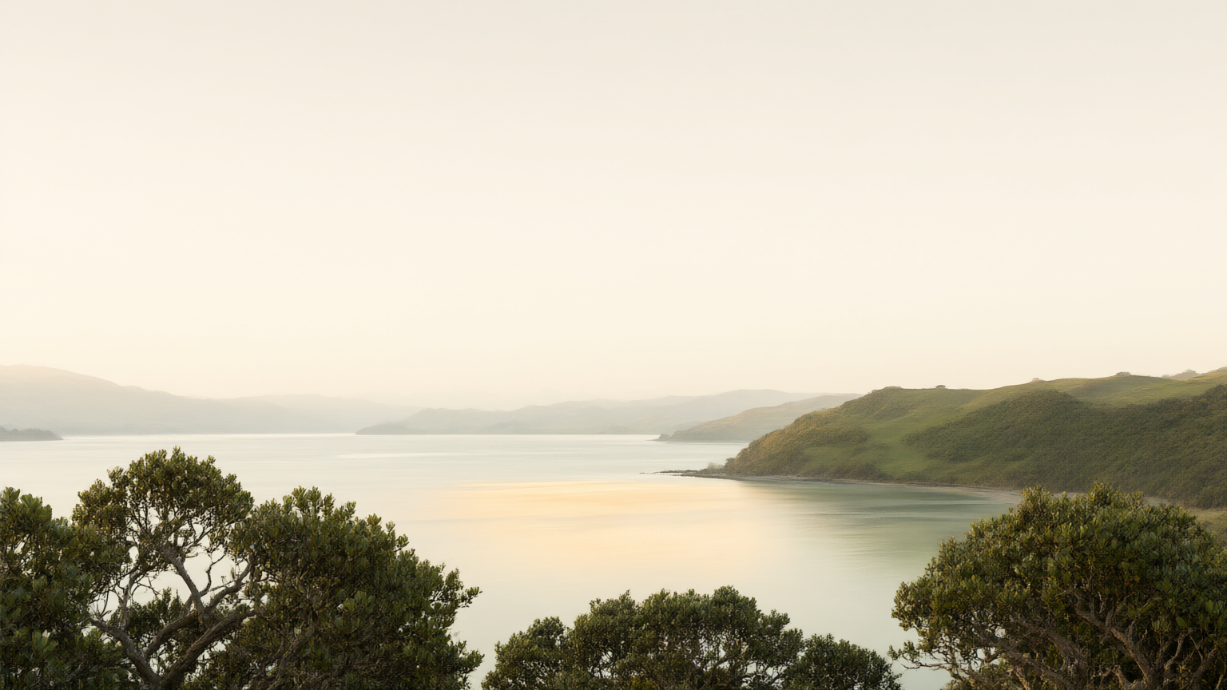
Kia noho ora tonu ngā kaumātua.
Older New Zealanders lead valued, connected and fulfilling lives.

